Slide 1


Slide 2




Slide 3


Watch: the Windfall story
Scan to open the full project
https://github.com/rahma-khaled/Healthcare

Slide 4
Project at A Glance
$1.27M
830
89
21
Total revenue
Orders
Customers
Countries
Northwind sales from July 1996 to May 1998, analysed in SQL Server and presented in Power BI.
Revenue = UnitPrice × Quantity × (1 − Discount). A late order shipped after its required date. May 1998 holds only 6 days of data.

Slide 5

CHAPTER 1
The Setting
Can we trust the data?

Slide 6
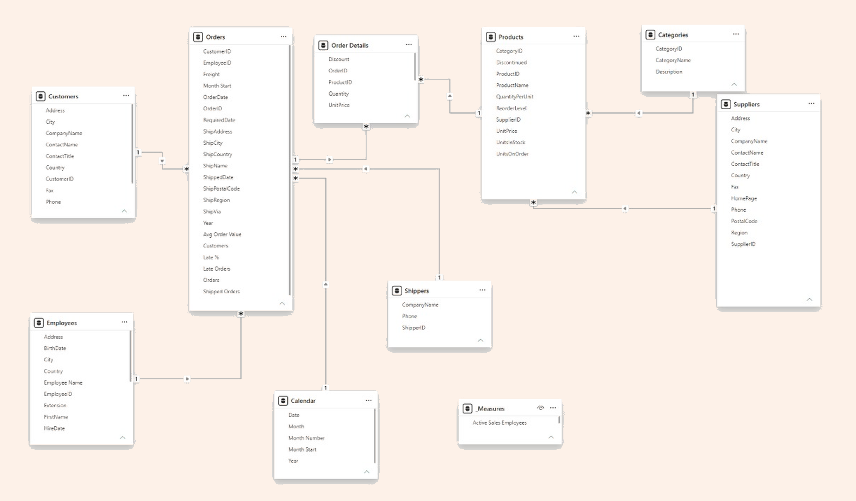
Data model: how the tables connect
91 Customers
830 Orders
2,155 Order Details
77 Products
29 Suppliers
9 Employees
3 Shippers
Setting
Rise
Twist
Decision

Slide 7
How each table links to the next
One side → Many side
Linked by
What it lets us do
Customers → Orders
Customer ID
Who placed each order
Employees → Orders
Employee ID
Which rep handled the order
Shippers → Orders
Shipped Via = Shipper ID
Which carrier delivered it
Calendar → Orders
Date and Order Date
Revenue by month and year
Orders → Order Details
Order ID
The products inside each order
Products → Order Details
Product ID
Which product was sold
Categories → Products
Category ID
Groups products by category
Suppliers → Products
Supplier ID
Who supplies each product
Setting
Rise
Twist
Decision

Slide 8
Q1 · Can we trust the data?
select round(sum(UnitPrice * Quantity * (1 - Discount)), 2) as my_total,
(select round(sum(Subtotal), 2)
from [Order Subtotals]) as northwind_total
from [Order Details];
1,265,793
Our revenue matches the built-in Northwind view
2,155 lines
8 tables checked: 830 orders, 91 customers, 77 products
Jul 1996 to May 1998
First and last order dates; 2 customers never ordered
Setting
Rise
Twist
Decision

Slide 9
Q2 · How do we build the full sales view?
select o.OrderID, c.CompanyName as customer, p.ProductName,
od.Quantity, od.UnitPrice, od.Discount,
round(od.UnitPrice * od.Quantity * (1 - od.Discount), 2) as line_total
from Orders o
inner join Customers c on c.CustomerID = o.CustomerID
inner join [Order Details] od on od.OrderID = o.OrderID
inner join Products p on p.ProductID = od.ProductID;
2,155 rows
One row per product in an order, not per order
4 tables
Orders, Customers, Order Details and Products joined by keys
830 orders
Split from Order Details so customer data is not repeated
Setting
Rise
Twist
Decision

Slide 10
Q3 · Who never ordered?
select c.CustomerID, c.CompanyName, c.Country
from Customers c
left join Orders o on o.CustomerID = c.CustomerID
where o.OrderID is null;
2 customers
Have no recorded orders: a follow-up opportunity
89 of 91
Customers who ordered at least once
LEFT JOIN
Keeps every customer, then keeps only those with no match
Setting
Rise
Twist
Decision

Slide 11

CHAPTER 2
The Rise
Where does revenue come from?

Slide 12
Q4 · How did revenue grow by year?
select year(o.OrderDate) as order_year,
count(distinct o.OrderID) as orders,
round(sum(od.UnitPrice * od.Quantity * (1 - od.Discount)), 2) as revenue
from Orders o
inner join [Order Details] od on od.OrderID = o.OrderID
group by year(o.OrderDate)
order by order_year;
208K / 617K / 441K
Revenue in 1996, 1997 and 1998 (partial years)
152 / 408 / 270
Orders in the same years
191K to 422K
Fair comparison: January to April, 1997 vs 1998
Setting
Rise
Twist
Decision

Slide 13
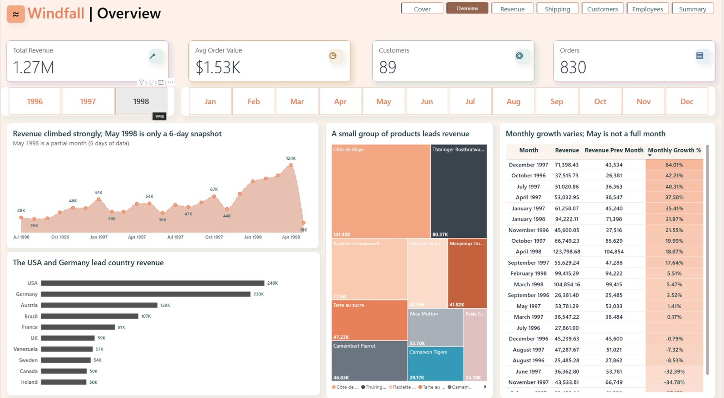
Overview: revenue is climbing, led by few products
Revenue $1.27M across 830 orders and 89 customers; average order $1.53K.
USA ($246K) and Germany ($230K) lead country revenue.
May 1998 is a 6-day snapshot, so its drop is not a real decline.
Setting
Rise
Twist
Decision

Slide 14
Q5 · Which categories earn the most?
select c.CategoryName,
round(sum(od.UnitPrice * od.Quantity * (1 - od.Discount)), 2) as revenue
from Categories c
inner join Products p on p.CategoryID = c.CategoryID
inner join [Order Details] od on od.ProductID = p.ProductID
group by c.CategoryName
order by revenue desc;
$267.9K
Beverages, 21.2% of revenue
$234.5K
Dairy Products, 18.5% of revenue
39.7%
Beverages and Dairy together
Setting
Rise
Twist
Decision

Slide 15
A quick question for you
?
45%
How much of our revenue comes from just 10 customers?
Take a guess before the answer appears.
Top 10 customers bring about 45% of revenue
Setting
Rise
Twist
Decision

Slide 16
Q6 · Which customers and countries matter most?
select top 10 c.CompanyName, c.Country,
round(sum(od.UnitPrice * od.Quantity * (1 - od.Discount)), 2) as revenue
from Customers c
inner join Orders o on o.CustomerID = c.CustomerID
inner join [Order Details] od on od.OrderID = o.OrderID
group by c.CompanyName, c.Country
order by revenue desc;
45%
Top 10 customers share of revenue
USA $246K
Germany $230K and Austria $128K follow
82%
Ernst Handel alone in Austria revenue
Setting
Rise
Twist
Decision

Slide 17
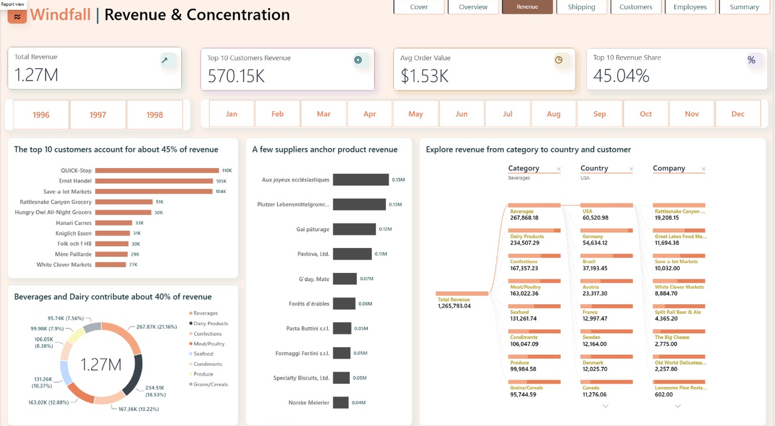
Revenue: a few customers and categories carry the business
Top 10 customers bring $570K, about 45% of revenue.
Beverages and Dairy contribute about 40% of revenue.
QUICK-Stop, Ernst Handel and Save-a-lot Markets lead the customers.
Setting
Rise
Twist
Decision

Slide 18
Revenue in three charts
Revenue by year
January to April
Top 3 countries
$K · 1998 is a partial year
$K · same months, 1997 vs 1998
$K revenue
January to April 1998 revenue is up 120.7% on 1997
Setting
Rise
Twist
Decision

Slide 19

CHAPTER 3
The Twist
What is quietly going wrong?

Slide 20
Q7 · Do customers come back?
select count(*) as repeat_customers
from (select CustomerID
from Orders
group by CustomerID
having count(*) > 1) t;
88 of 89
Customers ordered more than once
45%
Yet the top 10 customers hold almost half of revenue
16 silent
Customers quiet for 90+ days, worth $112.8K (Power BI)
Setting
Rise
Twist
Decision

Slide 21
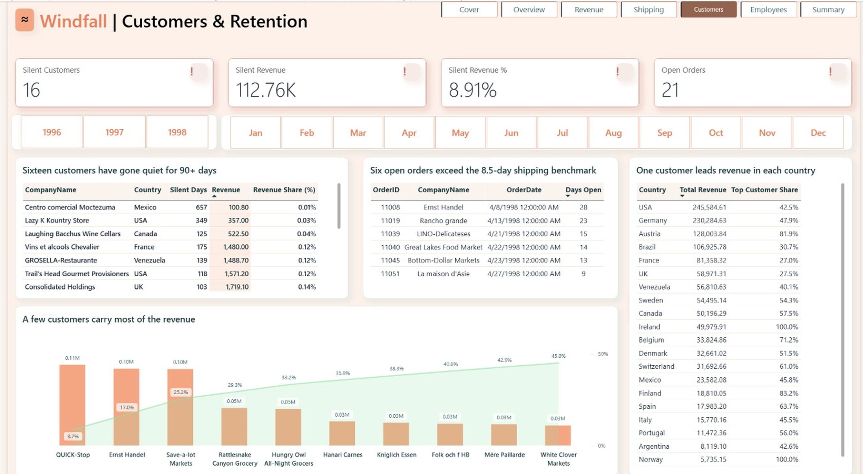
Customers: 16 high-potential accounts have gone quiet
16 customers silent for 90+ days represent $112.8K (8.9%) of revenue.
21 orders are still open; 6 exceed the 8.5-day shipping benchmark.
Every country has one leading customer, so concentration is common.
Setting
Rise
Twist
Decision

Slide 22
89 customers, one dot each
Who carries the business, and who has gone quiet?
89 customers ordered
Each dot is one customer · positions are illustrative
● Top 10 customers
45%
of all revenue comes from just 10 customers, about $570K
○ Silent for 90+ days
16
customers have gone quiet, worth $112.8K (8.9% of revenue)
Concentrated and quiet: that is where the risk lives
Setting
Rise
Twist
Decision

Slide 23
Customer heartbeat
Every order is a pulse. Here is what happened to 16 of our 89 customers.
73 accounts still ordering
16 accounts gone silent
73 accounts keep the revenue pulse going
$112.8K
8.9% of revenue, silent 90+ days
Windfall · Sales Intelligence · Heartbeat
Setting
Rise
Twist
Decision

Slide 24
Q8 · How reliable is shipping?
select sh.CompanyName as shipper,
count(*) as shipped_orders,
sum(case when o.ShippedDate > o.RequiredDate then 1 else 0 end) as late_orders
from Orders o
inner join Shippers sh on sh.ShipperID = o.ShipVia
where o.ShippedDate is not null
group by sh.CompanyName;
3.6% to 5.1%
Late rate: Federal 3.6, Speedy 4.9, United 5.1
8.49 days
Average time from order to shipment
5.1%
Freight cost as a share of revenue
Setting
Rise
Twist
Decision

Slide 25
Q9 · Who ships late, and what is still open?
select e.FirstName + ' ' + e.LastName as employee,
count(*) as shipped_orders,
sum(case when o.ShippedDate > o.RequiredDate then 1 else 0 end) as late_orders
from Orders o
inner join Employees e on e.EmployeeID = o.EmployeeID
where o.ShippedDate is not null
group by e.FirstName, e.LastName
order by late_orders desc;
37 of 809
Shipped orders arrived late
10 of 37
Late orders sit with Margaret Peacock: a pattern, not proof of cause
21 open
Orders not shipped yet
Setting
Rise
Twist
Decision

Slide 26
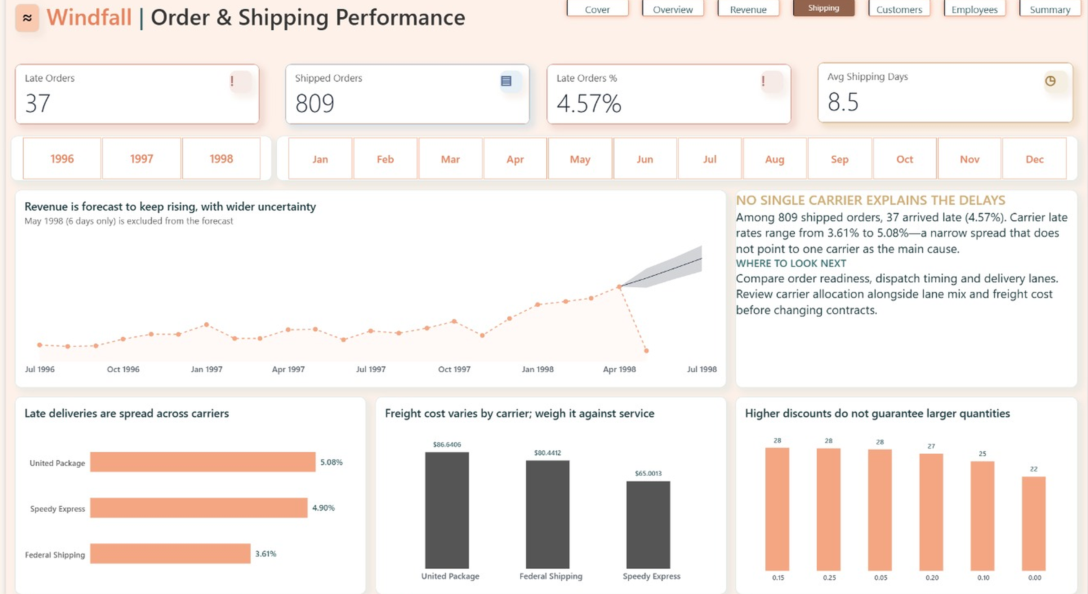
Shipping: late deliveries are not one carrier's problem
37 of 809 shipped orders arrived late (4.57%).
Carrier late rates sit in a narrow range, from 3.61% to 5.08%.
Review order readiness, dispatch timing and lanes before changing carriers.
Setting
Rise
Twist
Decision

Slide 27
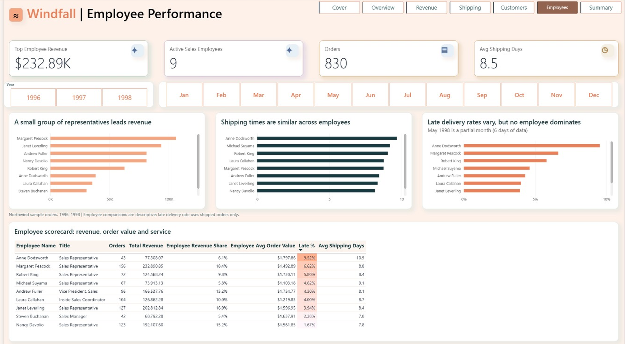
Employees: revenue is concentrated, service is similar
Margaret Peacock leads with $232.89K across 156 orders.
Average shipping time is similar across the team, 7.0 to 10.9 days.
Late rates range from 1.67% to 9.52%; no single employee dominates.
Setting
Rise
Twist
Decision

Slide 28
Q10 · Do discounts lift quantity?
select Discount,
count(*) as order_lines,
round(avg(cast(Quantity as float)), 1) as avg_quantity
from [Order Details]
group by Discount
order by Discount;
21.7 vs 25-28
Average quantity without a discount vs with 5% to 25%
88.7K
Discounts given, about 6.5% of sales before discount
1 product
Nord-Ost Matjeshering is below reorder level
Setting
Rise
Twist
Decision

Slide 29
The twist in three charts
Late orders
Top 10 customers
Silent accounts
37 of 809 shipped orders
share of total revenue
no order for 90+ days · $112.8K
4.57%
45%
16
A few accounts carry revenue, and part of it has gone quiet
Setting
Rise
Twist
Decision

Slide 30

Interactive Dashboard

Slide 31

4
CHAPTER 4
The Decision
What do we do on Monday?

Slide 32
The Windfall story in one picture
$1.27M
45%
$112.8K
4.57%
Revenue is climbing
A few accounts carry it
Quiet accounts at risk
Delivery is steady
Jan to Apr 1998 revenue is up 120.7% on 1997
Top 10 customers; Beverages and Dairy bring 39.7%
16 customers silent for 90+ days
37 of 809 shipped orders late; carriers 3.6% to 5.1%
Growth is real, but it is concentrated, and part of it has gone quiet
Setting
Rise
Twist
Decision

Slide 33
What to steer next
Growth is volume-led
Customer concentration needs protection
January to April 1998 revenue is up 120.7% while order volume is about 2.5× higher. Watch average order value and fulfilment capacity.
The top 10 customers bring about 45% of revenue. Protect key accounts and grow a credible second customer in each market.
Retention is a near-term opportunity
Delays are spread across carriers
Overall late rate is 4.57%. Examine processing time, dispatch timing and lanes before changing carrier allocation.
16 customers have been silent for 90+ days, worth about $112.8K. Assign owners to a targeted win-back sequence.
Setting
Rise
Twist
Decision

Slide 34
Recommendations for management
1
Protect key revenue streams. Monitor Beverages and Dairy availability, pricing and margin.
2
Manage customer concentration. Review the top 10 accounts and their revenue share monthly.
3
Improve delivery reliability. Investigate late shipments by carrier and order-level causes.
4
Strengthen replenishment. Review products below reorder level with nothing on order.
5
Use fair comparisons. Compare matching months; never treat partial years as full years.
Setting
Rise
Twist
Decision

Slide 35
What if we win back the quiet accounts?
25%
50%
100%
$28.2K
$56.4K
$112.8K
about 2.2% of total revenue
about 4.5% of total revenue
about 8.9% of total revenue
of the $112.8K from silent accounts
of the $112.8K from silent accounts
of the $112.8K from silent accounts
A scenario, not a forecast: even half of the quiet accounts is worth $56.4K
Setting
Rise
Twist
Decision

Slide 36
Three decisions we ask for today
1
2
3
Win back the quiet accounts
Protect the top 10
Fix delivery at the source
WHY
WHY
WHY
16 customers silent for 90+ days hold $112.8K.
10 customers bring about 45% of revenue.
37 of 809 orders were late (4.57%), across every carrier.
FIRST STEP
FIRST STEP
FIRST STEP
Assign one owner to each account.
Review these accounts every month.
Study order readiness and dispatch timing.
Approve the owners, the monthly review and the delivery check
Setting
Rise
Twist
Decision

Slide 37
Roadmap: from insight to action
Step 1: 16 customers silent for 90+ days hold $112.8K, 8.9% of revenue. Winning back half is worth $56.4K.
Step 2: The top 10 customers bring about $570K (45%). Ernst Handel alone is 82% of Austria's revenue.
Step 3: 37 of 809 shipped orders arrived late (4.57%), across every carrier. 21 orders are still open.
Step 4: Beverages ($267.9K) and Dairy ($234.5K) bring 39.7%. One product sits below reorder level.
4
Click a step to see why it matters
3
2
Ongoing
1
Days 61 to 90
Keep steering
Days 31 to 60
Fix delivery
Watch Beverages and Dairy supply and price
Restock products below reorder level
Days 0 to 30
Protect revenue
Check order readiness and dispatch timing
Clear the 6 open orders past 8.5 days
Win back
Review the top 10 accounts monthly
Grow a second key customer per market
Assign owners to 16 silent accounts ($112.8K)
Follow up the 2 customers with no orders
$112.8K
silent accounts at stake
45%
of revenue sits in the top 10
6
open orders past 8.5 days
39.7%
of revenue: Beverages + Dairy
Setting
Rise
Twist
Decision

Slide 38


Windfall story
App
Windfall – Northwind Sales Intelligence

Slide 39
Thank You

